Slide 1
Agriculture in Southern California Eric Larson Executive Director San Diego County Farm Bureau

Slide 2
County by County Value
Imperial $1,964,000,000
Ventura $1,800,000,000
San Diego $1,683,000,000
Riverside $1,282,000,000
San Bernardino $ 519,000,000
Los Angeles $ 173,000,000
Orange $ 145,000,000
Total $7,566,000,000

Slide 3
Leading Crops
Nursery and flowers (San Diego)
Strawberries (Ventura)
Lettuce (Imperial)
Milk (San Bernardino)
Avocados (Ventura – San Diego)
Cattle (Imperial)
Lemons (Ventura)
Celery (Ventura)
Tomatoes (Ventura)
Grapes (Riverside)
Eggs (San Diego)

Slide 4
Farm Water Usage
South Coast Hydrologic Unit
1.4 million acre fee
$4538 crop revenue per applied acre foot*
Colorado Hydrologic Unit
3.8 million acre feet
$607 crop revenue per applied acre foot
*excluding nursery

Slide 5
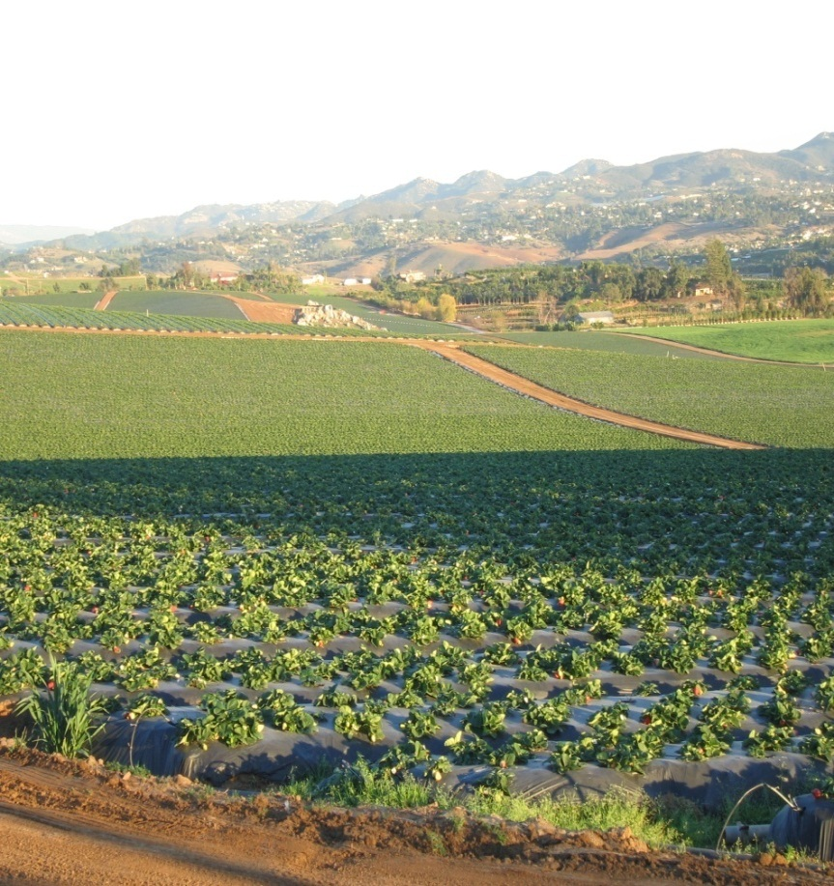
What Farming Means to the Community
Economic
Contribution to the economy
On farm + up and downstream jobs
Environmental
Air quality
Fire suppression
Open space
Wildlife corridors
Hedge against urbanization
Community Character
Local products
Ambiance

Slide 6
Current Challenges
Immigration reform
Pest exclusion and eradication
Competition from imports
Runoff compliance (conditional waivers)
Impact on nursery from slow economy
Soil fumigants for strawberries
Average age of farmers nearly 60

Slide 9
Water Uncertainties
Poor quality requires leaching
Supply reliability
Nursery requires high investment
Permanent crops take 5-10 years for peak production
Pricing
10,000 acres of avocados abandoned in San Diego in five years
Limited alternative crops

Slide 10
What’s on Farmers’ Minds
Dealing with regulatory burdens
Rising cost of production
Flat prices
Loss of farm chemicals
Labor shortage
Succession planning

